Slide 1
Ward Department
TEMPLATES

Slide 2
Templates Name
1
Dialysis Template

Slide 3
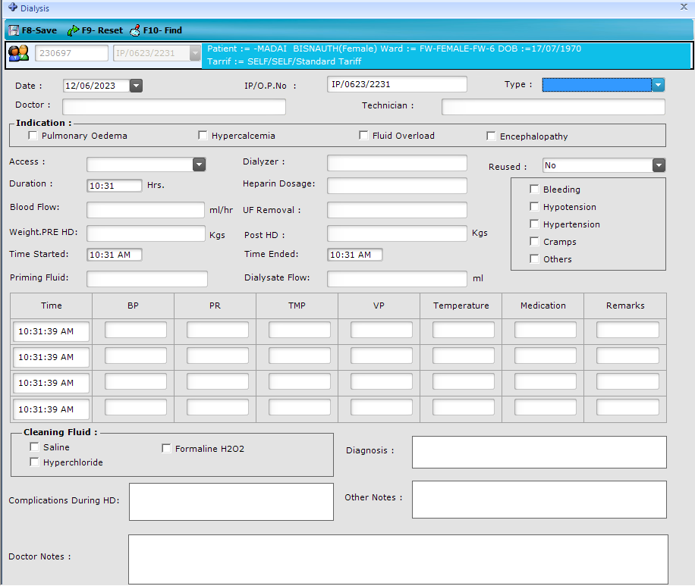

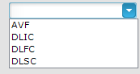

Slide 4
Templates Name
2
NICU Monitoring Chart

Slide 5
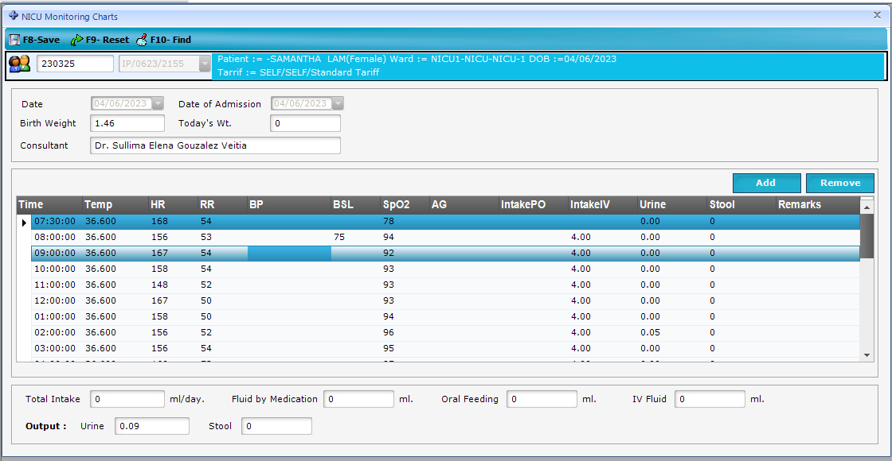

Slide 6
Templates Name
3
Pre Operative Order

Slide 7
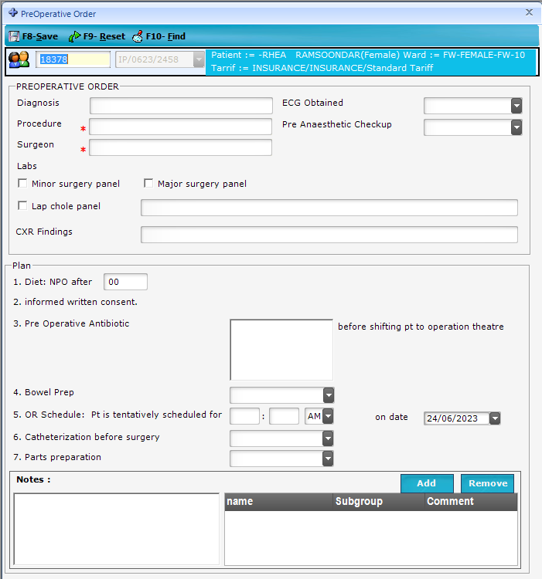
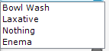
Procedure need to select option need
Surgeon name list need to show
Yes
No

Slide 8
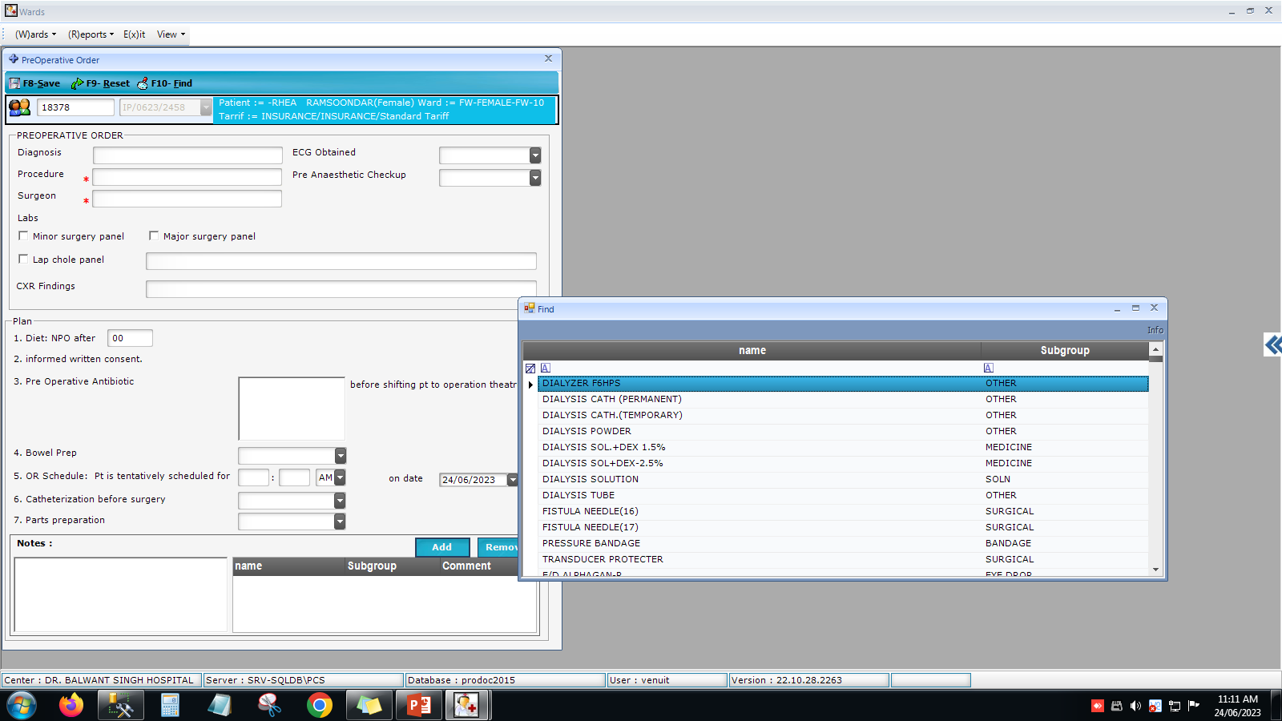

Slide 9
Templates Name
4
Post Operative Order

Slide 10
